Slide 1

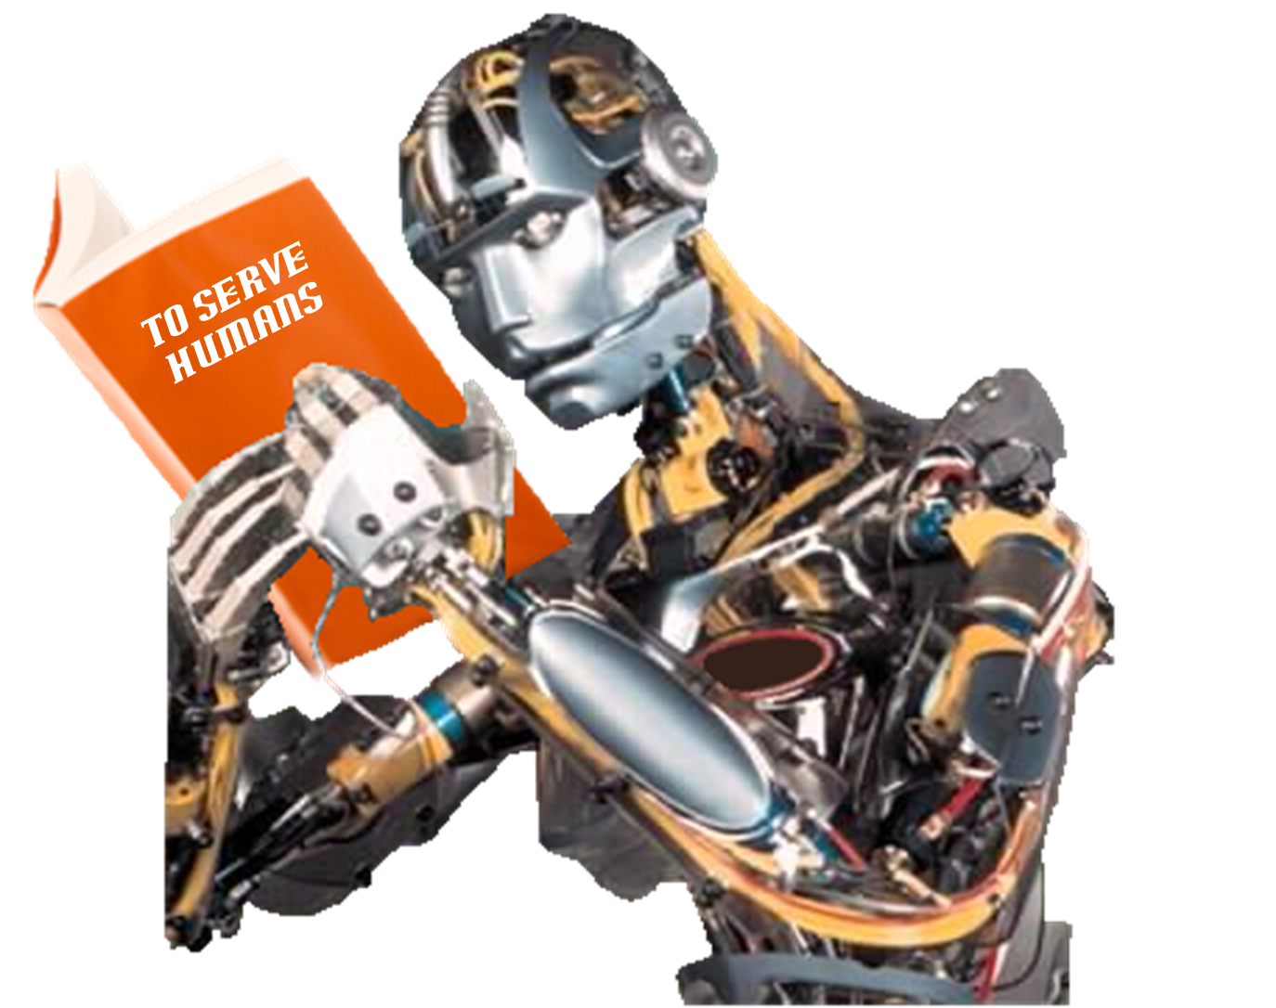
Histogram of Gradients as a discriminative tool to characterize biological signals
JIAAIS 2017
PhD Candidate:
Rodrigo Ramele
Dra. Julia Villar
Dr. Juan Santos
Co-Supervisor:
Advisor:
CiC - Center of Computational Intelligence
Computer Engineering Department
Instituto Tecnológico de Buenos Aires

Slide 2
Assistive Robotics
Based on Brain Computer
Interfaces
AUTOR:
Rodrigo Ramele
Dr. Juan Santos
DIRECTOR:
Doctorado Ingeniería en Informática
Instituto Tecnológico de Buenos Aires

Slide 3

Assistive Robotics
Based on Brain Computer
Interfaces
AUTOR
+1.000 proyectos en 50 países de América, Europa, Asia y África
+300 personas, +270 dedicadas a servicios de IT
Certificación ISO 9001:2008 en la gestión de servicios de software, desde 2008.
Calificación Investment Grade otorgada por Standard &Poor’s
Premio Sadosky 2011 a la Trayectoria Empresaria
35% de crecimiento promedio interanual desde 2002
Las empresas que conforman el 80% de nuestra facturación, tienen una antigüedad de entre 18 y 5 años.
Desde 2006, nuestro índice de Satisfacción de clientes supera al 90%.

Slide 4
Neurothronic
Control
Informatics
Electronics
Mechanics
Neuroscience
(*) 安川電機,1969
Yasukawa Denki

Slide 5
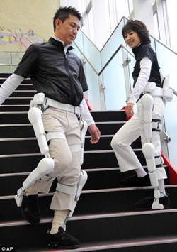
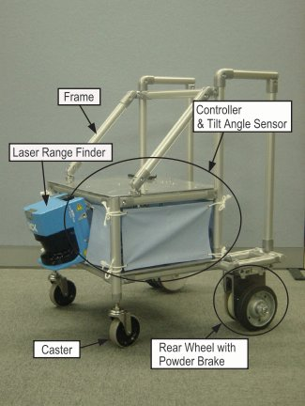
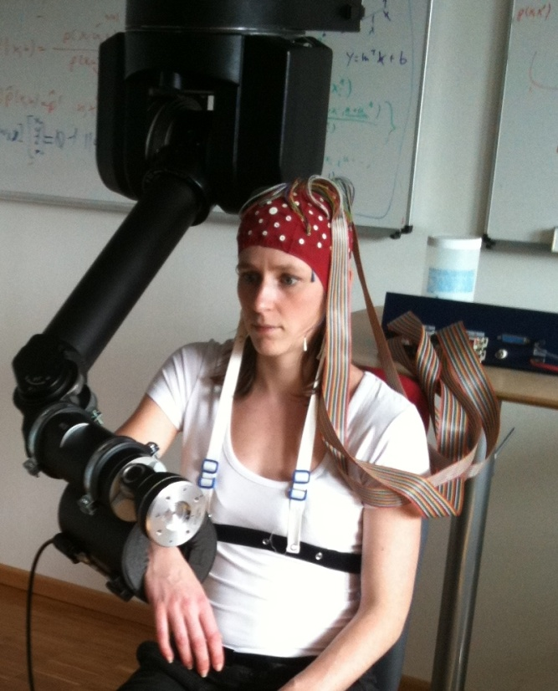
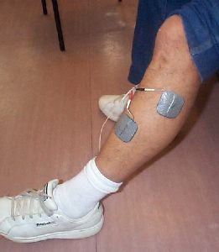
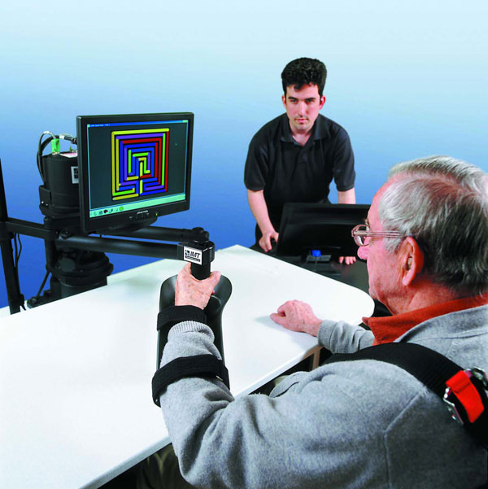
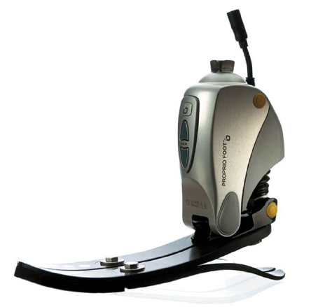
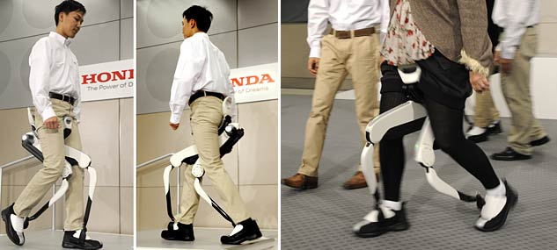
FES
Functional Electro Stimulation ( ETH Zurich)
Constrained Induced Movement Therapy (darmstadt, Germany)
Walking Helper Devices (Tohoku Univ., Japan)
HAL Exoskeleton
(Cyberdine Corp.)
MANUS (MIT)
Body Weight Support Assist (Honda)
Ossur noninvasive Orthopedics

Slide 6
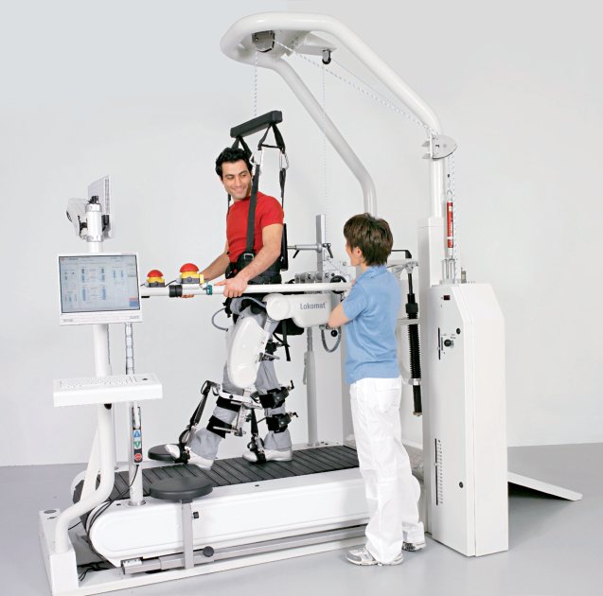
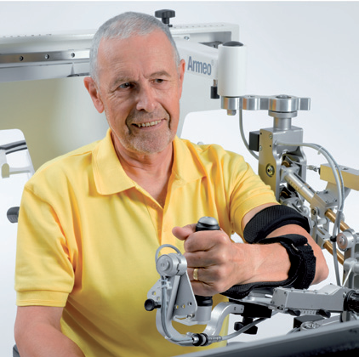
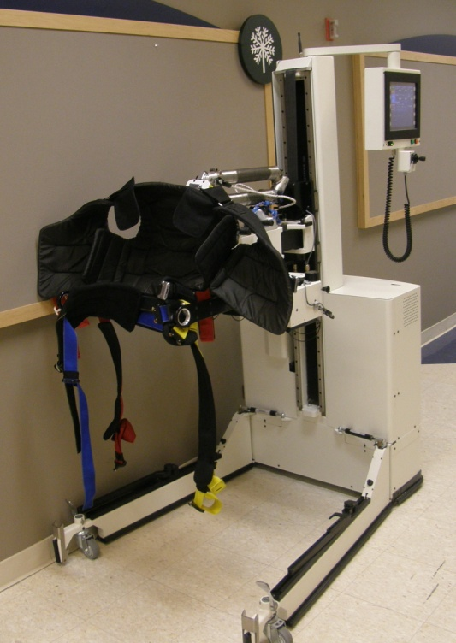
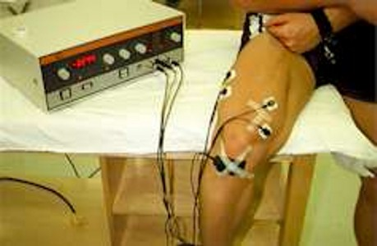
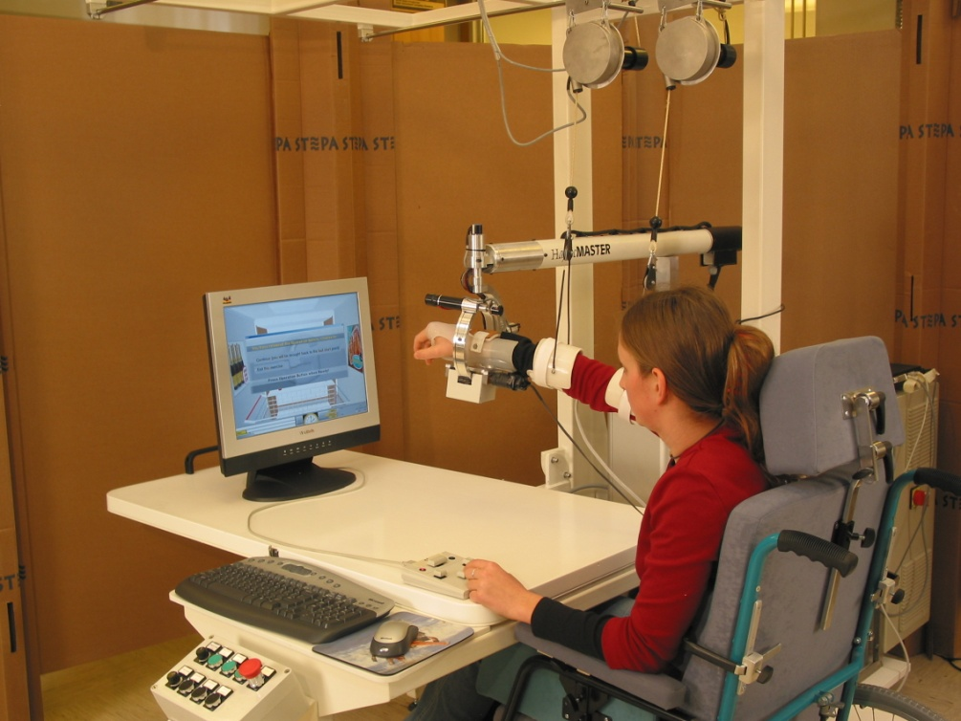
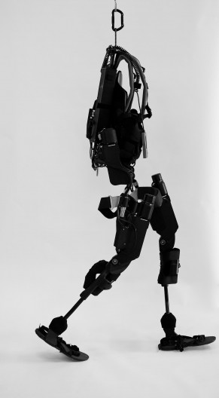
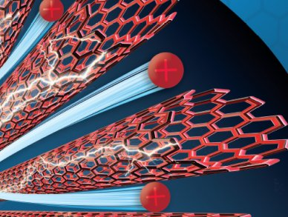
EMG
Electromyography
Lokomat (Univ. Of Chicago, Hacoma Corp.)
Aremo (Hacoma Corp.)
Kineassist (Kinea Design Corp.)
FES
Functional Electro Stimulation ( ETH Zurich)
EAP
Electro Active Polymers
eLEGS (Berkeley)
GENTLE/S (Reading Univ., UK)

Slide 7
Restauración de Andar
Reproducción del Ciclo Completo de Caminata utilizando FES + BCI
Gait
Gait Assesment (Evaluación y estandarización de la manera de andar)
Comprensión y Soporte del Balance en la asistencia a la rehabilitación
Análisis de Movimientos Humanos
Fugl-Meyer Score (Calidad del movimiento)
Obtener líneas de bases estandarizada de movimientos .
Comprensión del nivel de compromiso en el movimiento (engagement)
Static Aproximation Theory – Distribution Problem
Recuperación o bypass de sistemas nerviosos motores
Implantes sobre PNS (utilizando lo que exista de camino que todavía se encuentre allí)
Feedback Aumentado

Slide 8
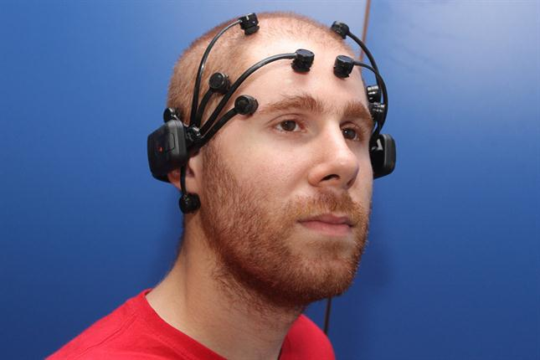
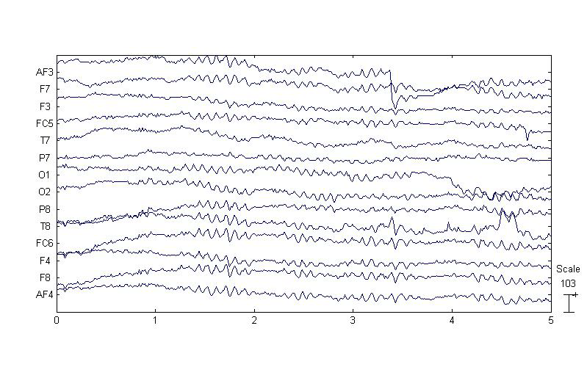
Brain Computer Interfaces
“A system which takes a biosignal measured from a person and predicts (in real time or online) some “abstract aspect of the person’s cognitive state” in a repeatable and reliable way.”
BNCI Horizon 2020: towards a roadmap for the BCI community, 2015, CNBI EPFL

Slide 9
Hybrid Brain Computer Interfaces and Wearables
“A system which takes a biosignal measured from a person and predicts (in real time or online) some “abstract aspect of the person’s cognitive state” in a repeatable and reliable way.”
EKG Electrocardiography
GSR Galvanic Skin Response
EMG Electromiography
BNCI Horizon 2020: towards a roadmap for the BCI community, 2015, CNBI EPFL

Slide 10
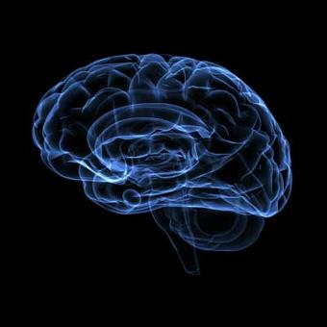
Brain Computer Interfaces
Classification
Feature
Extraction
Preprocessing
Signal
Acquisition
Measurement
Application
System
Closed Loop
Feedback
Volitional Control

Slide 11
Brain Computer Interfaces
Dorsal
Sagital
Plane
Vertex
Posterior
Anterior
Nasion
Horizontal
Plane
Inion
Ventral
Coronal
Plane

Slide 12
Brain Computer Interfaces
Frontal
C
E
N
T
R
A
L
Temporal
Temporal
Parietal
Occipital
Nicolelis, 2000

Slide 13
Wearables Sensors, mHealth, and BCI
Brain Computer Interfaces
Human Augmentation: Cyborgs
Prothesis
Exoskeletons
Assistive Devices
BioChips
Cochlear Implant
NeuroBusiness
Neuromarketing
Neuroergonomy
Neurorehabilitation
Wearables
mHealth
Personal Analytics
http://www.gartner.com/newsroom/id/3412017

Slide 14
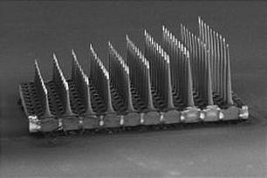

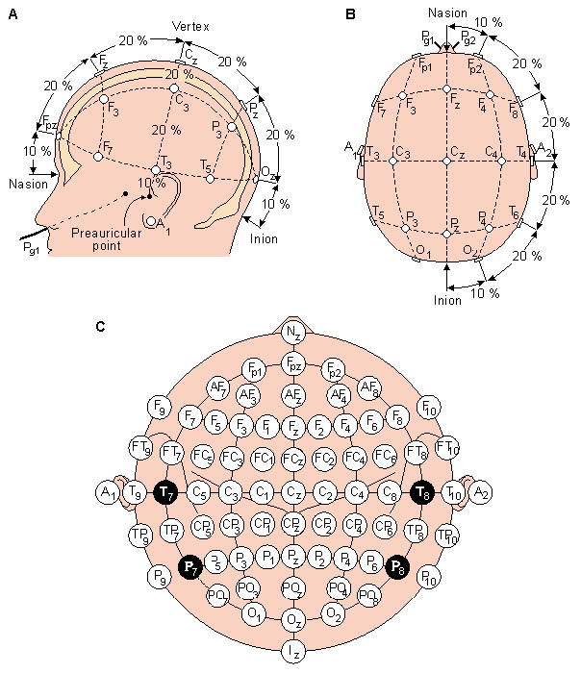
Brain Computer Interfaces: Mature?
EEG Electroencefalográma
ECoG Electrocorticography
MEG Magnetoencefalografía
fMRI Resonancia Magnética Funcional
PET Tomografía por Emisión de Positrones
fTCD Functional TransCranial Doppler
fNIR functional Near InfraRed
BCI Introduction, Rao 2013

Slide 15
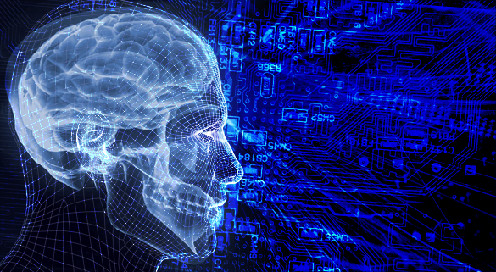
Brain Computer Interfaces based on EEG
Increase!
ITR, SNR, Reliability, Portability, UX, Out-of-lab-ization
Decrease
Setup, Trainning and,Calibration Time.
Inter/Intra variability.
Evoked Potential
Steady State Visual Evoked Potential
Bereitschaftspotentials
Motor Imagenary:
ERD/ERS: Event Related Desynchronization-Synchronization
Wadsworth BCI
Graz BCI
Selective Attention
P300,N400
Visual Spatial Evoked Attention
Mental Tasks
Operant Conditioning:
Slow Cortical Potentials
ErrP
Berlin BCI
“We yet have an impractical and inaccessible exotica for very specific user groups"
“Effectiveness of non-invasive BCI systems remain limited…”
“…to ponder if BCIs are really promising and helpful, or if they are simple a passing rod, reinforced by their sci-fi side..."
Allison 2010, Wolpaw and Wolpaw 2011, Lotte 2016

Slide 16

Current Challenges
Real life user-requirements and complexity in adapting a commercial application to every kind of user.
BCI systems must go beyond the decoding of neural signals: human factors, aesthetics, etc
Real Life EEG Signals are different from those generated at lab environments.
Lack of clear metrics to assest BCI performance
Reduced or biased control populations (i.e. Graduate students).
Basic Research to understand relations between Cognitive phenomena and EEG.
Alternative frameworks that help clinical collaboration.
Improve close collaboration with physicians and clinical adoption.
Whats wrong with us? Roadblocks and pitfalls in designing BCI applications, Asilomar 2016

Slide 17
Drawbacks: Rehabilitation Robotics and Assistive Devices
Health Care Industry does not trust Neurorehabilitation Robotics
Nonexistent or Invalid Clinical Trials Procedures for Assistive Devices
Lack of Reliable Assesment Indexes.
Invalid or absent clinical validation
Incorrect characterization of clinical protocols.
Engagement.
ASSIST-AS-NEEDED
Laziness Robots.

Slide 18
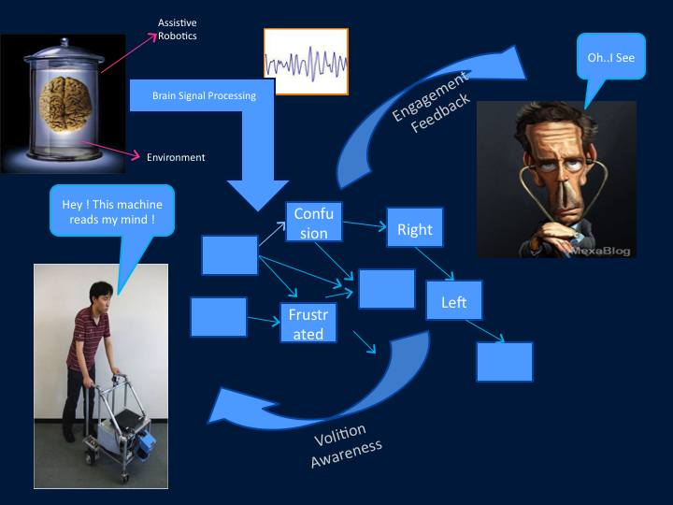
RQ:Rehabilitation Procedures are improved by using a Cognitive Monitoring BCI Device?

Slide 19
BCI:Brain Computer Interfaces
EEG Electroencefalográma
ECoG Electrocorticography
MEG Magnetoencefalografía
fMRI Resonancia Magnética Funcional
PET Tomografía por Emisión de Positrones
fTCD Functional TransCranial Doppler
fNIR functional Near InfraRed
Notes:
Este tema se hace particularmente complejo en casos de Stroke donde justamente gracias a la plasticidad que tanto estudiamos la mejor rehabilitación posible.

Slide 20
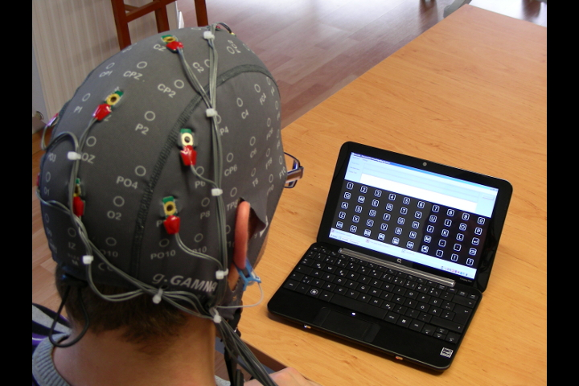
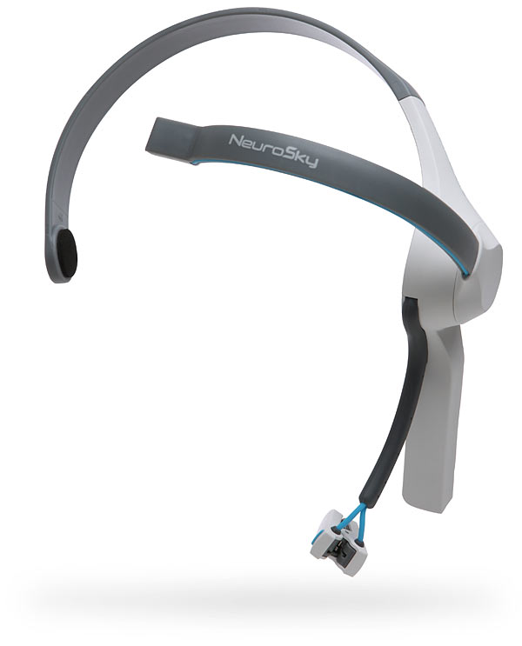
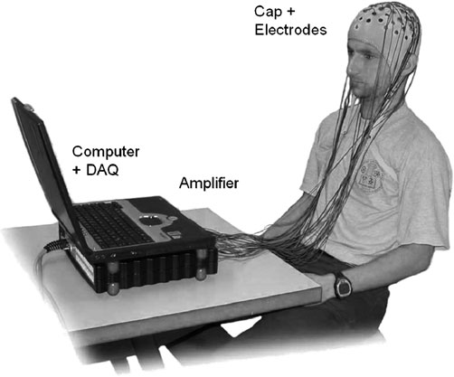
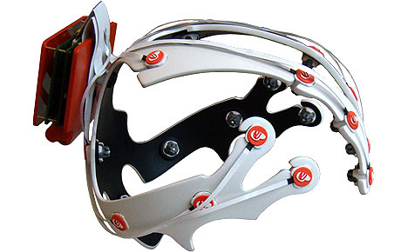
BCI:Brain Computer Interfaces
NeuroSky
g.TECBCI
Orientación al cliente:
El cliente es nuestra razón de ser y trabajamos para él.
Esperamos que vos te comprometas junto con nosotros a cuidar esta relación
Emotiv Co. Epoc Headset
EEG BCI Device
Notes:
Este tema se hace particularmente complejo en casos de Stroke donde justamente gracias a la plasticidad que tanto estudiamos la mejor rehabilitación posible.

Slide 21
BCI:Brain Computer Interfaces
NeuroSky
g.TECBCI
Orientación al cliente:
El cliente es nuestra razón de ser y trabajamos para él.
Esperamos que vos te comprometas junto con nosotros a cuidar esta relación
Emotiv Co. Epoc Headset
EEG BCI Device
Notes:
Este tema se hace particularmente complejo en casos de Stroke donde justamente gracias a la plasticidad que tanto estudiamos la mejor rehabilitación posible.

Slide 22
BCI:Brain Computer Interfaces
Notes:
Este tema se hace particularmente complejo en casos de Stroke donde justamente gracias a la plasticidad que tanto estudiamos la mejor rehabilitación posible.

Slide 23
BCI SIFT

Slide 24
BCI:Brain Computer Interfaces based on EEG
“We yet have an impractical and inaccessible exotica for very specific user groups"
Increase!
ITR, SNR, Reliability, Portability, UX, Out-of-lab-ization
Decrease
Setup, Trainning and,Calibration Time.
Inter/Intra variability.
Evoked Potential
Steady State Visual Evoked Potential
Bereitschaftspotentials
Motor Imagenary:
ERD/ERS: Event Related Desynchronization-Synchronization
Wadsworth BCI
Graz BCI
Selective Attention
P300,N400
Visual Spatial Evoked Attention
Operant Conditioning:
Slow Cortical Potentials
ErrP
Berlin BCI
“…to ponder if BCIs are really promising and helpful, or if they are simple a passing rod, reinforced by their sci-fi side..."
“Effectiveness of non-invasive BCI systems remain limited…”
Wolpaw and Wolpaw 2011, Allison 2010, Lotte 2016

Slide 25
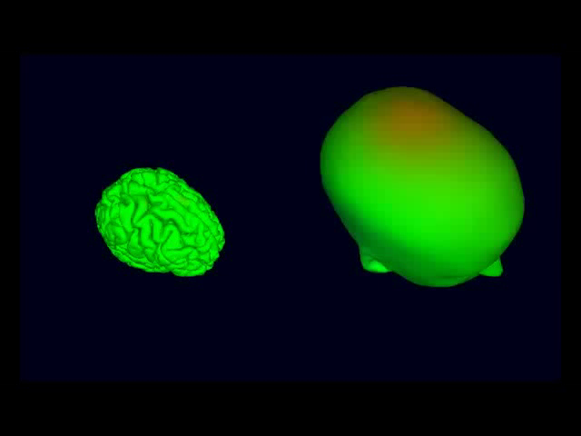
Swartz Center for Computational Neuroscience, UCSD

Slide 26
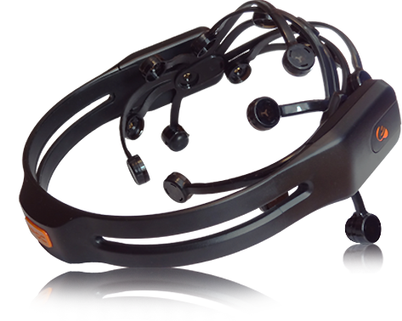
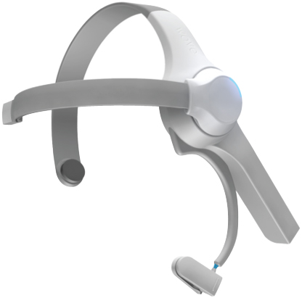
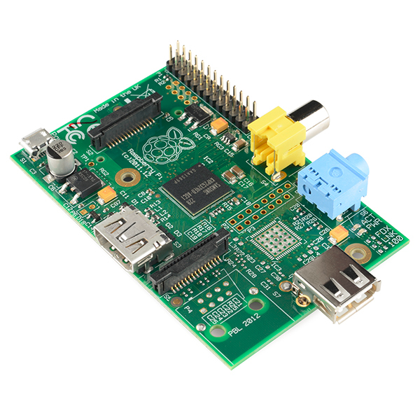
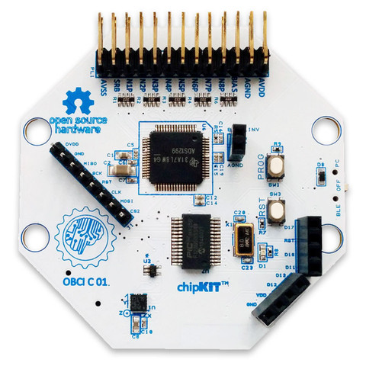
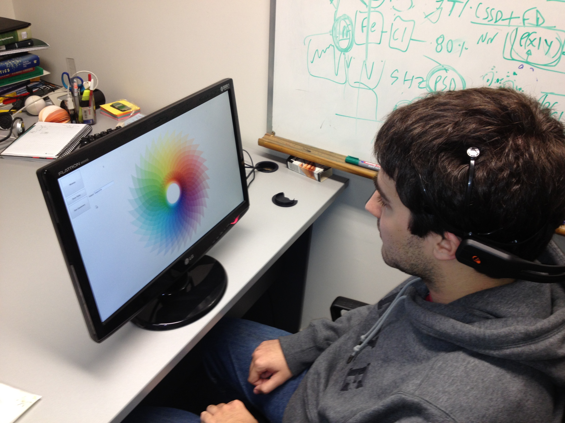
BCI:Brain Computer Interfaces
NeuroSky
Afordable in terms of Cost, with Wearable Commercial Devices (i.e.EPOC Emotiv).
RaspberryPi
OpenBCI
Stopczynski et al,2014
Notes:
Stopczynski

Slide 27
Allison B.Z.,2010

Slide 28
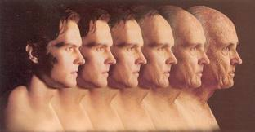

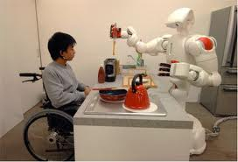
BCI X EEG

Slide 29
Just Noise?
Are those visual wiggles simple noise or can we extract something meaningful, i.e. a cognitive correlation, a hand movement, or a different physical posture?
For instance, routinely physicians explore morphologically these raw EEG signals scavenging for signs of disease or irregular patterns looking for sleep spindles, Lambda waves, K-Complexes, Vertex waves, Positive Occipital Sharp Transients and more visual features. What if we mimic them systematically and automatically ?
Notes:
A Brain Computer Interface classification method based on SIFT descriptors
Benjamin Blankertz, Gabriel Curio and Klaus-Robert Müller, Classifying Single Trial EEG: Towards Brain Computer Interfacing

Slide 30
Morphological Signal Template Matching
Shape Domain Analysis (Allen, Millrs, 2007)
Multiresolution Slope Recognition
Shape Features (Alvarez Gonzales,2014)
Mathematical Morphology and Signal Processing
https://physionet.org/physiobank/ Datasets
Notes:
A Brain Computer Interface classification method based on SIFT descriptors
https://physionet.org/physiobank/
Benjamin Blankertz, Gabriel Curio and Klaus-Robert Müller, Classifying Single Trial EEG: Towards Brain Computer Interfacing

Slide 31
Histogram of Oriented Gradients

Slide 32
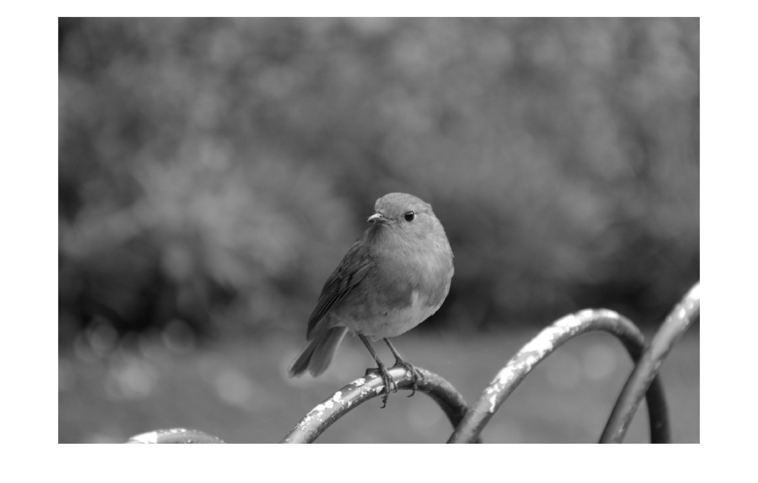
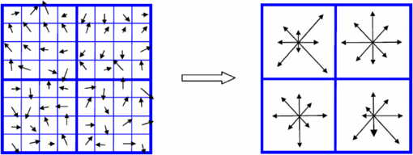
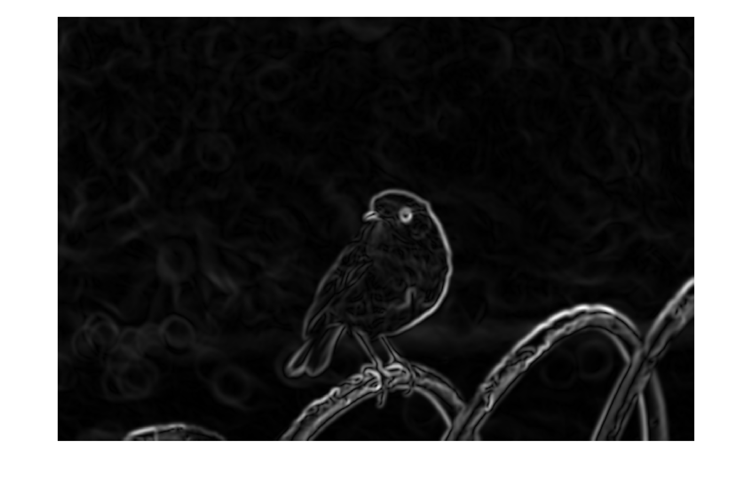
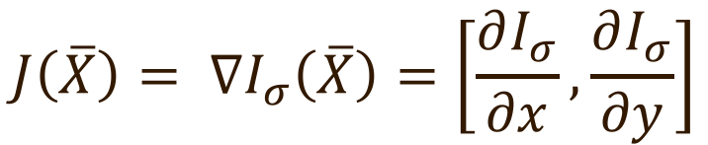
Histogram of Oriented Gradients
$$J\left(\overline{X}\right)= ∇I_{σ}\left(\overline{X}\right)=\left[\frac{∂I_{σ}}{∂x},\frac{∂I_{σ}}{∂y}\right]$$
Edelman, Intrator, Poggio, 1997
Notes:
Scharr or Sobel operator

Slide 33
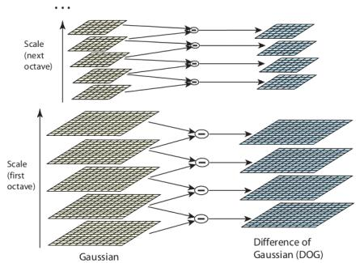
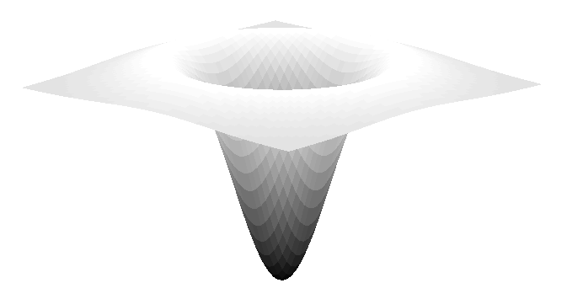
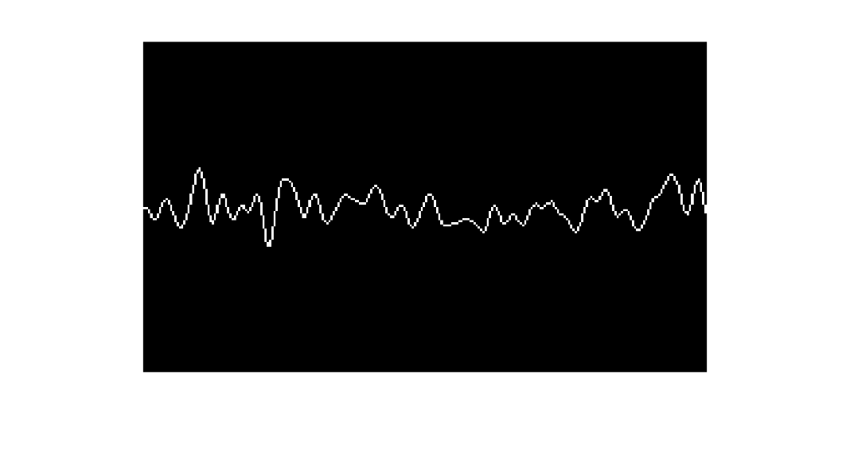
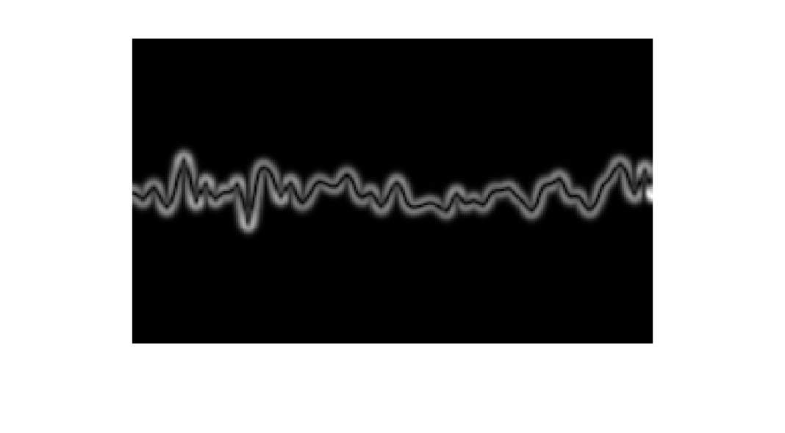
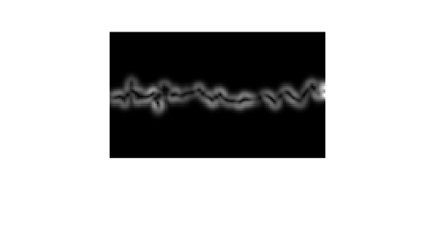
Histogram of Oriented Gradients
DoG Operator → LoG
Witkin 1983, Lindeberg, 1994, Lowe, 2004, Vedaldi 2010
Notes:
Scharr or Sobel operator

Slide 34
Histogram of Oriented Gradients for SIFT Descriptor
Rey-Otero, Anatomy of the SIFT Descriptor, 2013
Notes:
A Brain Computer Interface classification method based on SIFT descriptors
Benjamin Blankertz, Gabriel Curio and Klaus-Robert Müller, Classifying Single Trial EEG: Towards Brain Computer Interfacing

Slide 35
Application to Electroencephalography

Slide 36
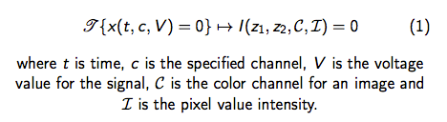
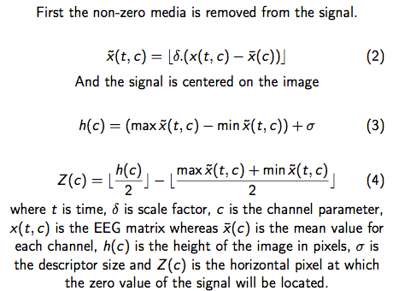
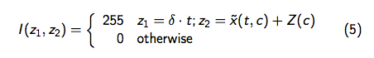
Histogram of Oriented Gradients for EEG signals
Santos, Villar, Ramele, 2016, IEEE BCI WINTER Conference
Notes:
Scharr or Sobel operator

Slide 37
SIFT Features
Vedaldi 2010
Notes:
A Brain Computer Interface classification method based on SIFT descriptors
Benjamin Blankertz, Gabriel Curio and Klaus-Robert Müller, Classifying Single Trial EEG: Towards Brain Computer Interfacing

Slide 38
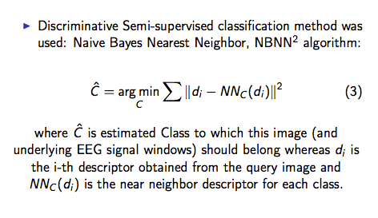
Feature Classification
Near Neighbout Naive Bayes Classification Algorithm
Boiman, Shechtman, Irani 2008
Notes:
A Brain Computer Interface classification method based on SIFT descriptors
Benjamin Blankertz, Gabriel Curio and Klaus-Robert Müller, Classifying Single Trial EEG: Towards Brain Computer Interfacing

Slide 39
Results
Notes:
A Brain Computer Interface classification method based on SIFT descriptors
Benjamin Blankertz, Gabriel Curio and Klaus-Robert Müller, Classifying Single Trial EEG: Towards Brain Computer Interfacing

Slide 40
Results
Notes:
A Brain Computer Interface classification method based on SIFT descriptors
Benjamin Blankertz, Gabriel Curio and Klaus-Robert Müller, Classifying Single Trial EEG: Towards Brain Computer Interfacing

Slide 41
EEG Classification: Occipital Alpha Waves
Santos, Villar, Ramele, 2016; Goldberg et al 2000, Schalk 2004
Notes:
A Brain Computer Interface classification method based on SIFT descriptors
Benjamin Blankertz, Gabriel Curio and Klaus-Robert Müller, Classifying Single Trial EEG: Towards Brain Computer Interfacing

Slide 42
EEG Classification: Motor Imagery
Santos, Villar, Ramele, 2016; Steyrl, Scherer et al 2015.
Notes:
A Brain Computer Interface classification method based on SIFT descriptors
Benjamin Blankertz, Gabriel Curio and Klaus-Robert Müller, Classifying Single Trial EEG: Towards Brain Computer Interfacing

Slide 43
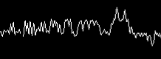
Datasets
Dataset II
Dataset I
BCI Competition 2003, dataset IV self-paced 1s
The recording was made using a NeuroScan amplifier and a Ag/AgCl electrode cap from ECI. 28 EEG channels were measured at positions of the international 10/20-system (F, FC, C, and CP rows and O1, O2). Signals were recorded at 1000 Hz with a band-pass filter between 0.05 and 200 Hz.
Blankertz, 2002, Stopczynski et al,2014
Notes:
A Brain Computer Interface classification method based on SIFT descriptors
Benjamin Blankertz, Gabriel Curio and Klaus-Robert Müller, Classifying Single Trial EEG: Towards Brain Computer Interfacing

Slide 44
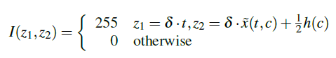
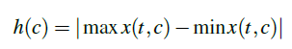
Image generation and feature extraction
Lowe,2004, Vedaldi 2010
Notes:
A Brain Computer Interface classification method based on SIFT descriptors

Slide 45




Results and Conclusions
We presented a method for EEG signal feature extraction and classification. We verified here that the procedure can be successfully applied to two physiologically meaningful
datasets and that it is possible to discriminate known EEG signals based solely on their plots according to the proposed algorithm. If the correct values for parameters are used, the proposed method could successfully classify the signals of both datasets without any a priori knowledge of the signals.
This is an advantage since the classical way to address the classification problem for the first Dataset is analyzing the frequency space, while for the second Dataset, the analysis is done in the temporary space.
Bresenham, 1965,Lowe,2004, Vedaldi 2010
Notes:
A Brain Computer Interface classification method based on SIFT descriptors

Slide 46


Electroencephalography P300 Speller
Evoked Potential which is fired 300 ms after the onset of an external stimuli (e.g. Light flashing) and can be detected on the EEG signal.
Notes:
A Brain Computer Interface classification method based on SIFT descriptors
Benjamin Blankertz, Gabriel Curio and Klaus-Robert Müller, Classifying Single Trial EEG: Towards Brain Computer Interfacing

